Slide 1
States of Matter
Chemistry
The Four States of Matter
Notes:
Matter can be defined as anything that takes up space, has mass, and has inertia. Chemistry is the study of matter and its interactions. This is an introduction to the most basic categories of matter.

Slide 2
States of Matter
The Four States of Matter
Four States
Solid
Liquid
Gas
Plasma
Notes:
The most basic classification scheme of matter is based on the states of solid, liquid, gas, and plasma. Of these the least discussed in most texts is plasma even though it is the most abundant of all states. 99% of all matter in the universe is plasma.

Slide 3
States of Matter
The Four States of Matter
Basis of Classification of the Four Types
Based upon particle arrangement
Based upon energy of particles
Based upon distance between particles
Notes:
The different states of matter are categorized by the arrangement and energy of the particles at normal temperatures and pressures. The state of matter can be altered by adding or removing energy and/or pressure which can affect the arrangement and energy of the particles.

Slide 4
States of Matter
Solids
Particles of solids are tightly packed, vibrating about a fixed position.
Solids have a definite shape and a definite volume.
Solids have an infinite number of free surfaces.

Slide 5
States of Matter
Solids
Particle Movement Examples

Slide 6
States of Matter
Liquids
Particles of liquids are tightly packed, but are far enough apart to slide over one another.
Liquids have an indefinite shape and a definite volume.
Liquids have one free surface.

Slide 7
States of Matter
Liquids
Particle Movement Examples

Slide 8
States of Matter
Gases
Particles of gases are very far apart and move freely.
Gases have an indefinite shape and an indefinite volume.
Gases have no free surfaces.

Slide 9
States of Matter
Gases
Particle Movement Examples
Notes:
Particles of a gas move randomly and must be contained from all surfaces.

Slide 10
States of Matter
Plasma
A plasma is an ionized gas.
A plasma is a very good conductor of electricity and is affected by magnetic fields.
Plasma, like gases have an indefinite shape and an indefinite volume.
Notes:
In a plasma the electrons have been stripped away from the central nucleus. Therefore, a plasma consists of a sea of ions and electrons and is a very good conductor of electricity and is affected by magnetic fields. Electrons are separated from their respective nucleus when enough heat is applied. In a controlled thermonuclear fusion research, plasmas are heated to over 100 million degrees.

Slide 11
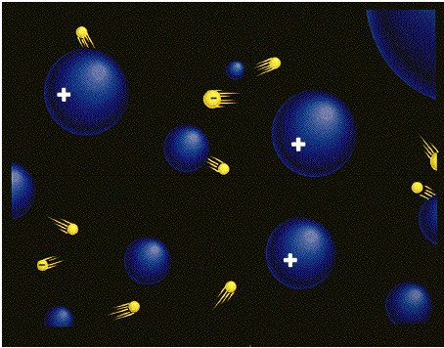
States of Matter
Plasma
Particles
The negatively charged electrons (yellow) are freely streaming through the positively charged ions (blue).
Notes:
The negatively charged electrons (yellow) are freely streaming through the positively charged ions (blue).

Slide 12
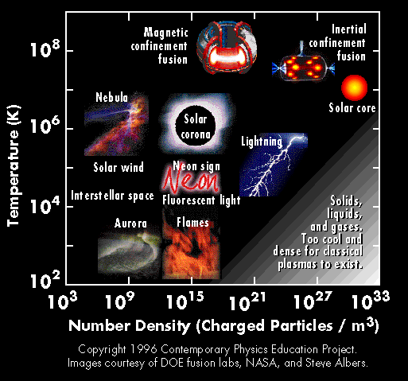
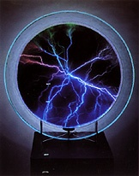
States of Matter
Plasma
Examples
Notes:
Plasma can be found in stars, fluorescent light bulbs, Cathode Ray Tubes, neon signs, and lightening.

Slide 13
States of Matter
Microscopic Explanation for Properties of Solids
Solids have a definite shape and a definite volume because the particles are locked into place
Solids are not easily compressible because there is little free space between particles
Solids do not flow easily because the particles cannot move/slide past one another

Slide 14
States of Matter
Microscopic Explanation for Properties of Liquids
Liquids have an indefinite shape because the particles can slide past one another.
Liquids are not easily compressible and have a definite volume because there is little free space between particles.
Liquids flow easily because the particles can move/slide past one another.

Slide 15
States of Matter
Microscopic Explanation for Properties of Gases
Gases have an indefinite shape and an indefinite volume because the particles can move past one another.
Gases are easily compressible because there is a great deal of free space between particles.
Gases flow very easily because the particles randomly move past one another.

Slide 16
States of Matter
Microscopic Explanation for Properties of Plasmas
Plasmas have an indefinite shape and an indefinite volume because the particles can move past one another.
Plasmas are easily compressible because there is a great deal of free space between particles.
Plasmas are good conductors of electricity and are affected by magnetic fields because they are composed of ions (negatively charged electrons and positively charged nuclei).
Notes:
In a plasma the electrons have been stripped away from the central nucleus. Therefore, a plasma consists of a sea of ions and electrons and is a very good conductor of electricity and is affected by magnetic fields. Electrons are separated from their respective nucleus when enough heat is applied. In a controlled thermonuclear fusion research, plasmas are heated to over 100 million degrees.

Slide 17
States of Matter
The Four States of Matter
The Classification and Properties of Matter Depend Upon Microscopic Structure
Particle arrangement
Particle energy
Particle to particle distance
Notes:
The different states of matter are categorized by the arrangement and energy of the particles at normal temperatures and pressures. The state of matter can be altered by adding or removing energy and/or pressure which can affect the arrangement and energy of the particles.

